Slide 1

What’s going on in the market and economy
Peer analysis and member trends data
Balance sheet strategies
Tools and products available through your membership in FHLBank Topeka
Notes:
Welcome to new series
Format of series
Introduce myself and Drew
Housekeeping:
- recorded, copy of slides and replay link will be sent
- use Q&A to submit questions, we’ll get to those at the end
- 1 CPE credit
Go to first poll question

Slide 2
Cautionary Statements Regarding Forward-Looking Statements & Disclaimer
Forward –looking statements: The information in this presentation contains forward-looking statements within the meaning of the safe harbor provisions of the Private Securities Litigation Reform Act of 1995. Such forward-looking statements include statements describing the objectives, projections, estimates or future predictions of FHLBank Topeka’s operations. These statements may be identified by the use of forward-looking terminology such as “anticipates,” “believes,” “may,” “is likely,” “could,” “estimate,” “expect,” “will,” “intend,” “probable,” “project,” “should,” or their negatives or other variations of these terms. FHLBank cautions that by their nature forward-looking statements involve risks or uncertainties and that actual results may differ materially from those expressed in any forward-looking statements as a result of such risks and uncertainties, including but not limited to: changes in the general economy and capital markets, the rate of inflation, employment rates, housing market activity and pricing, the size and volatility of the residential mortgage market, geopolitical events, and global economic uncertainty; political events, including legislative, regulatory, judicial, or other developments that affect FHLBank; its members, counterparties or investors in the consolidated obligations of the FHLBanks, such as any government-sponsored enterprise (GSE) reforms, any changes resulting from the Federal Housing Finance Agency’s (FHFA) review and analysis of the FHLBank System, including recommendations published in its “FHLBank System at 100: Focusing on the Future” report, changes in the Federal Home Loan Bank Act of 1932, as amended (Bank Act), changes in applicable sections of the Federal Housing Enterprises Financial Safety and Soundness Act of 1992, or changes in other statutes or regulations applicable to the FHLBanks; external events, such as economic, financial, or political disruptions, and/or wars, pandemics, and natural disasters, including disasters caused by climate change, which could damage our facilities or the facilities of our members, damage or destroy collateral pledged to secure advances, or mortgage-related assets, which could increase our risk exposure or loss experience; effects of derivative accounting treatment and other accounting rule requirements, or changes in such requirements; competitive forces, including competition for loan demand, purchases of mortgage loans and access to funding; the ability of FHLBank to introduce new products and services to meet market demand and to manage successfully the risks associated with all products and services; changes in demand for FHLBank products and services or consolidated obligations of the FHLBank System; membership changes, including changes resulting from member creditworthiness, member failures or mergers, changes due to member eligibility or housing mission focus, or changes in the principal place of business of members; changes in the U.S. government’s long-term debt rating and the long-term credit rating of the senior unsecured debt issues of the FHLBank System; soundness of other financial institutions, including FHLBank members, non-member borrowers, counterparties, and the other FHLBanks and their members, non-member borrowers, and counterparties; the ability of each of the other FHLBanks to repay the principal and interest on consolidated obligations for which it is the primary obligor and with respect to which FHLBank, along with the other FHLBanks, has joint and several liability; the volume and quality of eligible mortgage loans originated and sold by participating members to FHLBank through its various mortgage finance products (Mortgage Partnership Finance® (MPF®) Program). “Mortgage Partnership Finance,” “MPF,” “MPF Xtra,” and “MPF Direct” are registered trademarks of FHLBank Chicago; changes in the fair value and economic value of, impairments of, and risks associated with, FHLBank’s investments in mortgage loans and mortgage-backed securities (MBS) or other assets and related credit enhancement protections; changes in the value or liquidity of collateral underlying advances to FHLBank members or non-member borrowers or collateral pledged by reverse repurchase and derivative counterparties; volatility of market prices, changes in interest rates and indices and the timing and volume of market activity, including the effects of these factors on amortization/accretion; gains/losses on derivatives or on trading investments and the ability to enter into effective derivative instruments on acceptable terms; changes in FHLBank’s capital structure; FHLBank's ability to declare dividends or to pay dividends at rates consistent with past practices; the ability of FHLBank to keep pace with technological changes and innovation such as artificial intelligence, and the ability to develop and support technology and information systems, including the ability to manage cybersecurity risks and securely access the internet and internet-based systems and services, sufficient to effectively manage the risks of FHLBank’s business; and the ability of FHLBank to attract, onboard and retain skilled individuals, including qualified executive officers.
Disclaimer: In connection with the preparation and provision of these materials (including all data, scenarios, valuations, projections and other information in these materials, collectively the “Materials”), FHLBank has relied upon and assumed, without independent investigation or verification, the accuracy and completeness of all financial and other information that was made available, supplied, or otherwise communicated to FHLBank by our members and other publicly available information. FHLBank expressly disclaims any responsibility for or liability in connection with the Materials or your use of the Materials. The Materials are necessarily based upon economic, market, financial and other conditions as they exist on, and on the information made available to us as of, the date of the Materials, and subsequent developments may affect the analyses, information or other contents in the Materials. The Materials are solely for information purposes and are provided as an accommodation and without charge. All scenarios in the Materials were derived using estimates and assumptions about relevant future market conditions and other matters, all of which are subject to change without notice. FHLBank makes no representations or warranties about the accuracy or suitability of any information in the Materials. The Materials do not constitute legal, regulatory, accounting, investment, or financial advice or the rendering of legal, accounting, consulting, or other professional services of any kind. You are strongly encouraged to consult with qualified professionals regarding the extent to which the Materials may be useful to you and with respect to any legal, regulatory, accounting, tax, business, and/or financial matters or questions. The Materials are confidential and are not to be published, quoted or referred to, in whole or in part, in any document for any purpose without FHLBank ’s written consent.

Slide 3


Presenters
Drew Simmons
VP, Regional Account Manager – Oklahoma
405.831.7678
drew.simmons@fhlbtopeka.com
Leslie Mondesir
AVP, Marketing and Member Solutions Manager
785.478.8183
leslie.mondesir@fhlbtopeka.com

Slide 4
Discussion Topics
Economic Update
Member Financial Trends
Funding Strategies & Considerations
FHLBank Update on Capitol Hill
FHLBank Community and Grant Programs

Slide 5
Poll Questions
Do you need CPE credit for today’s webinar?
Yes
No
Which area of the webinar are you most excited to learn about today?
market and economic update
peer analysis and member trends
funding strategies and considerations
FHLBank update

Slide 6
Economic Update

Slide 7
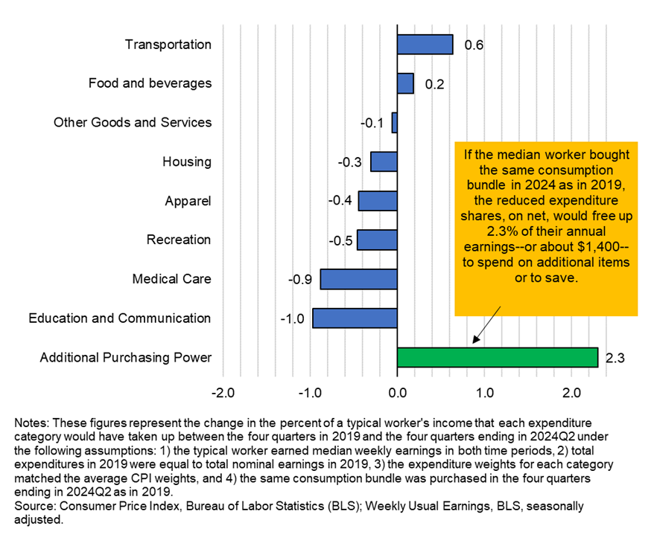
Economic Outlook
Inflation Improving, Labor Market Weakening,
& Rates Falling
Will the Fed Finally Cut Rates?
GDP | 3.00%
Core PCE | 2.80%
Core CPI | 3.20%
U3 Unemployment Rate | 4.30%
HPI YOY | 5.73%
Pending Home Sales | -5.50%

Slide 8
Poll Question
How many rate cuts do you think the Fed will do for the rest of the year?
0
1-2
3-4
More than 4

Slide 9
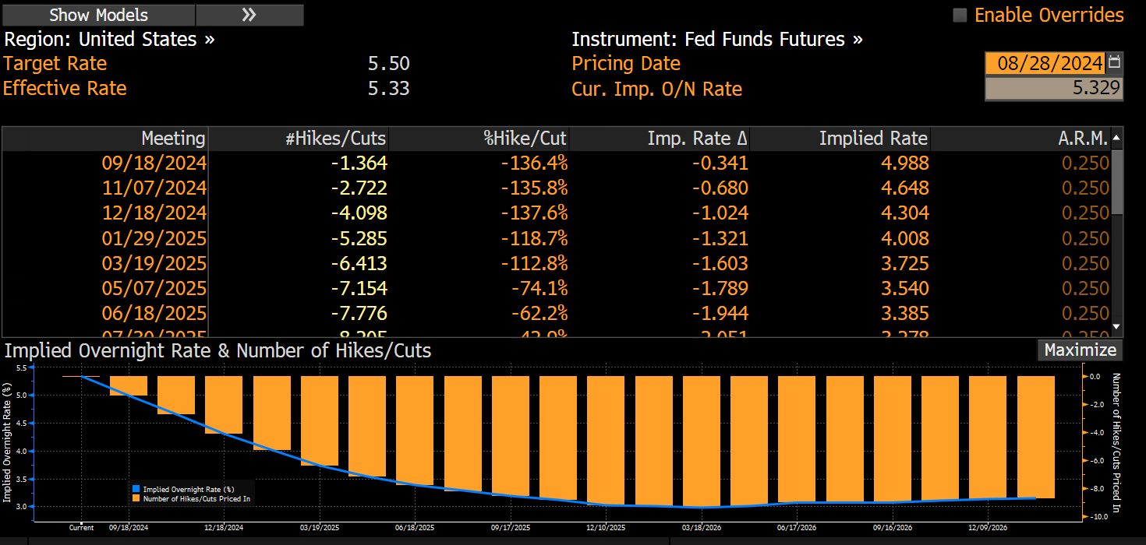
Fed Funds Futures | Now Projecting 4 Cuts by Year-End
Source: Bloomberg.

Slide 10
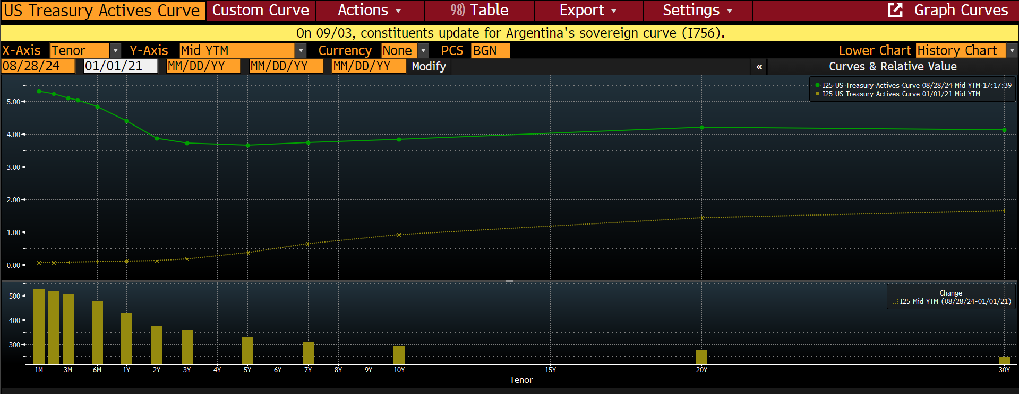
Yield Curve – Prepare for a Bull Steepening
Source: Bloomberg.

Slide 11
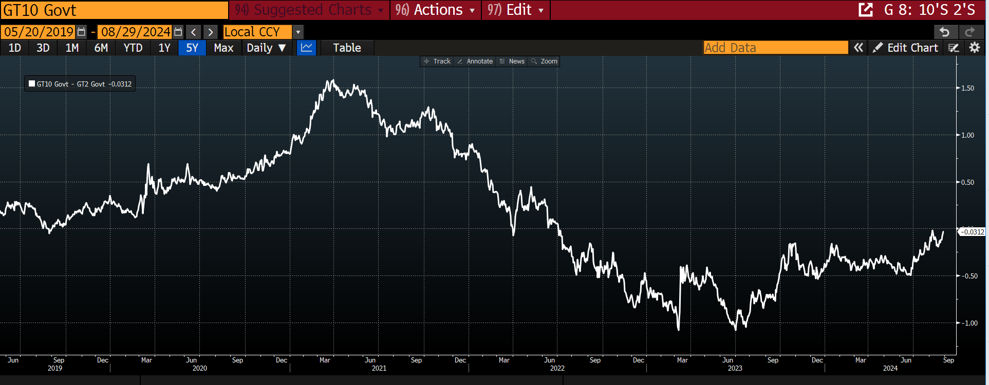
Treasury 10s/2s Spread 3bps from Even – Longest Inversion on Record
Source: Bloomberg.

Slide 12
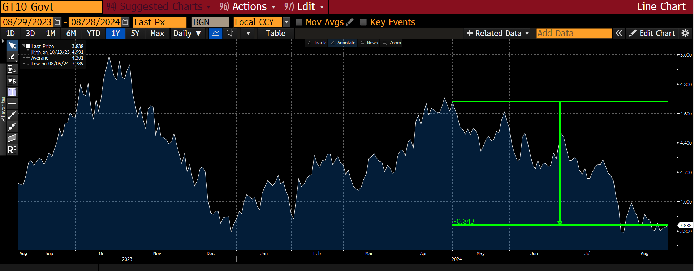
10-Year Treasury Has Rallied 84bps Since May – 3.83%
Source: Bloomberg.

Slide 13
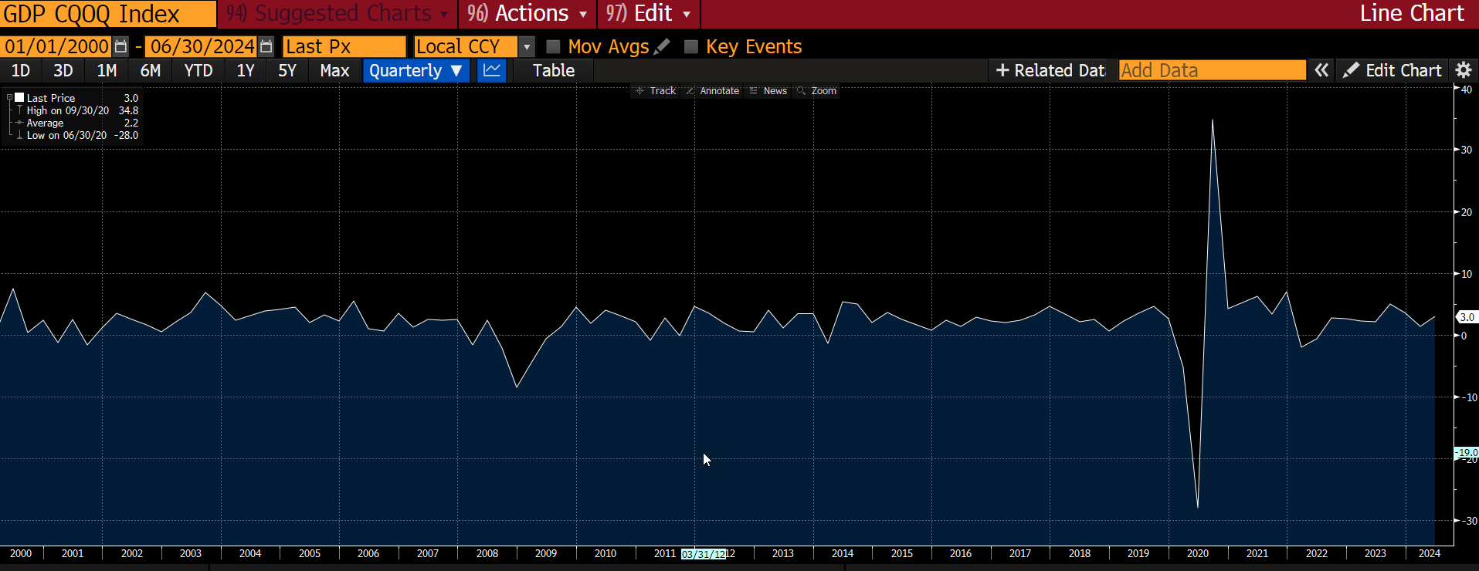
Q2 GDP – 2ND Estimate 3.00%
Source: Bloomberg.

Slide 14
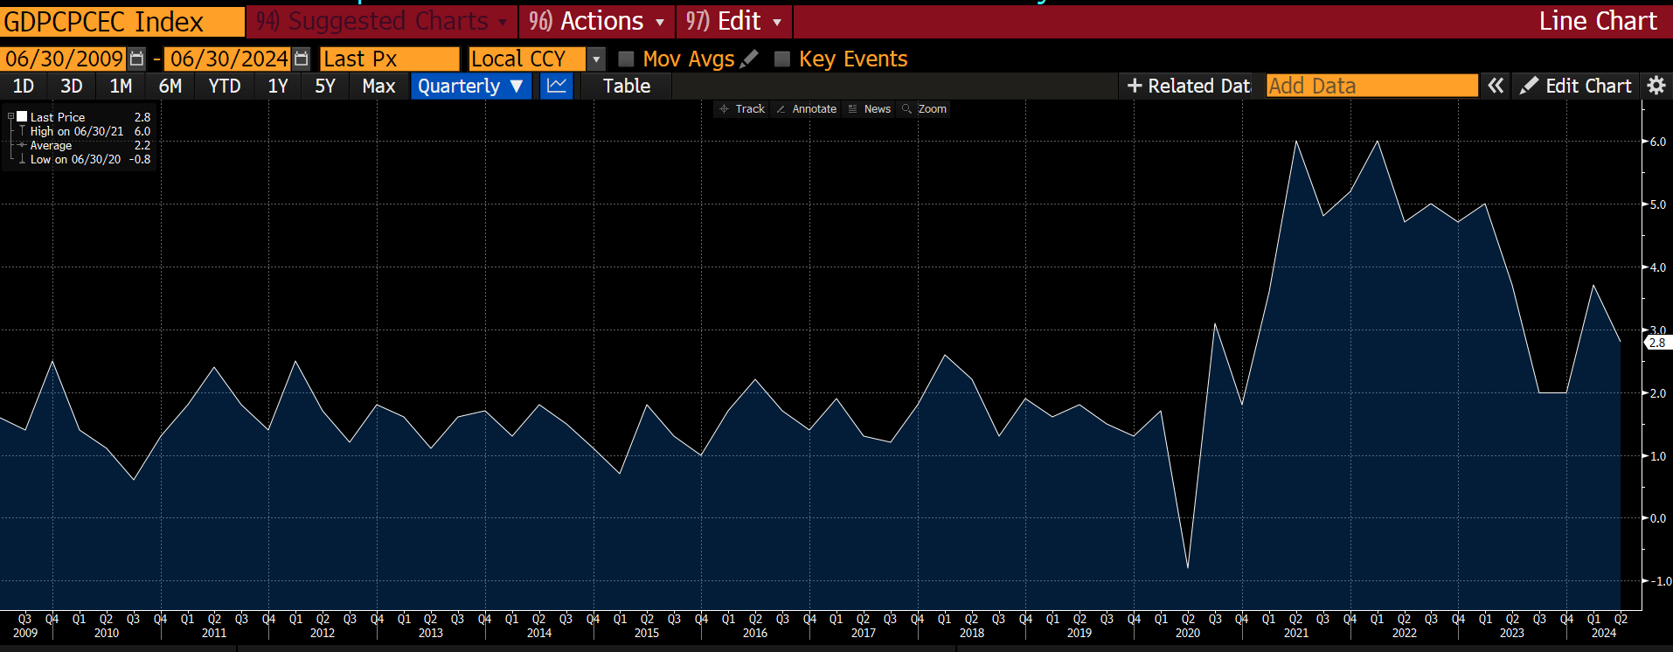
Quarterly Core PCE| 2.80%
Source: Bloomberg.

Slide 15
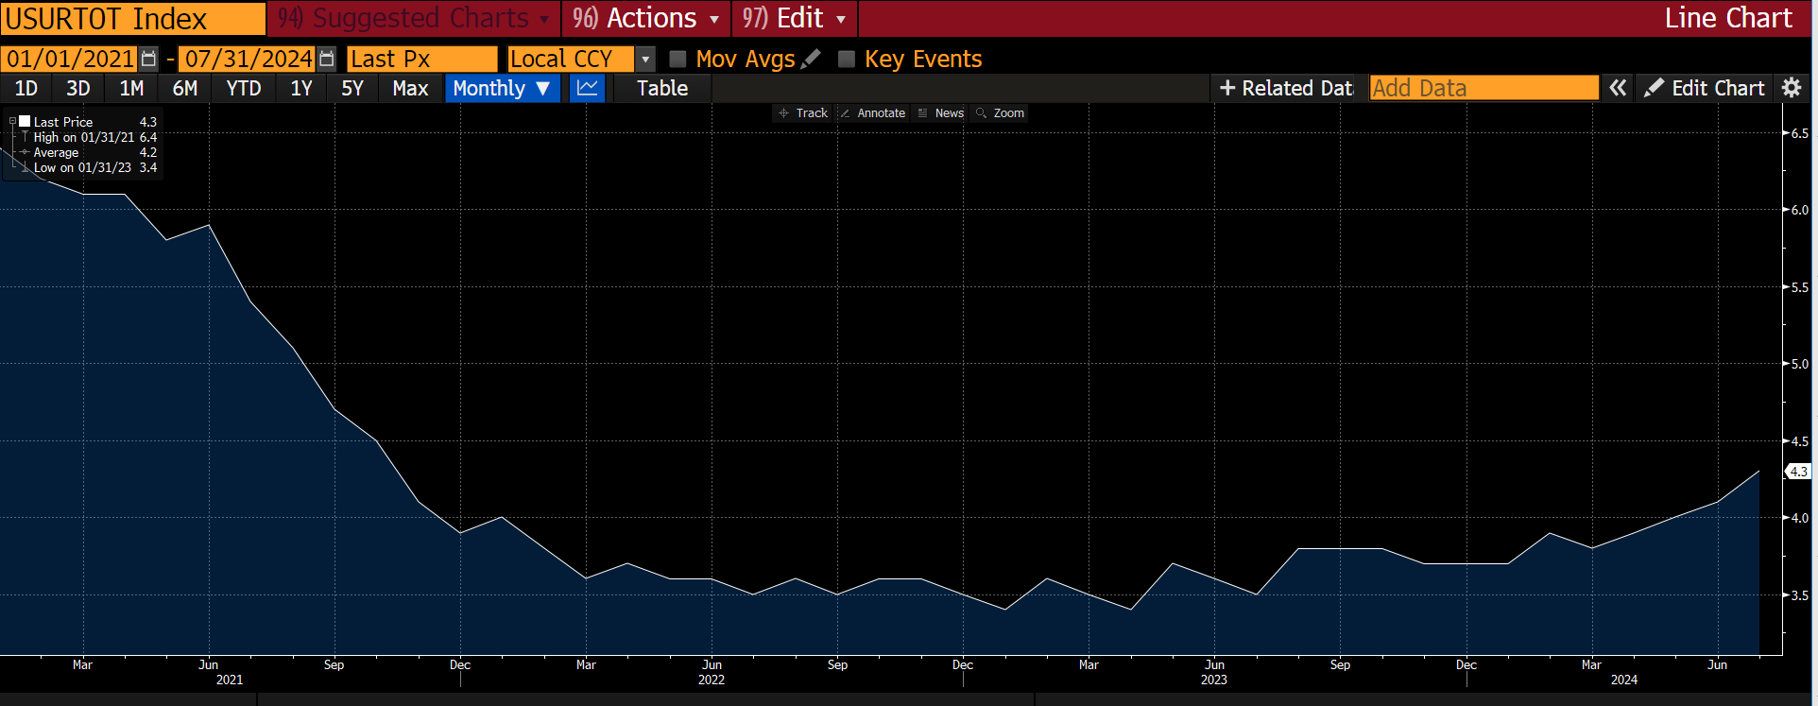
U3 Unemployment Rate Highest Since October 2021 | 4.30%
Source: Bloomberg.

Slide 16
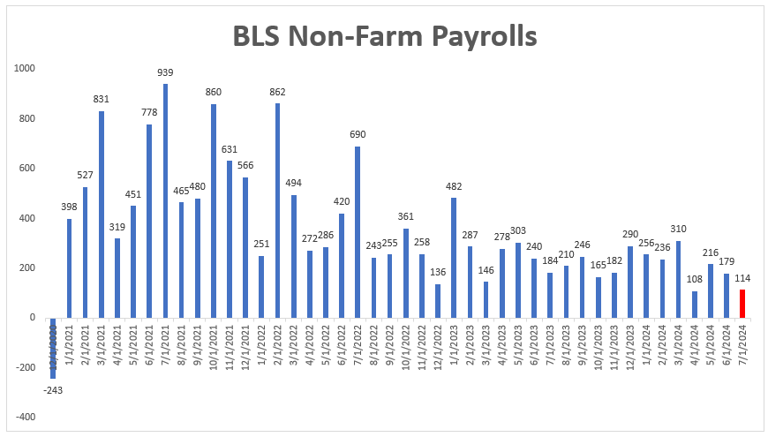
July’s Change in Non-Farm Payrolls lowest Since Dec 2020
Source: US Bureau of Labor Statistics

Slide 17
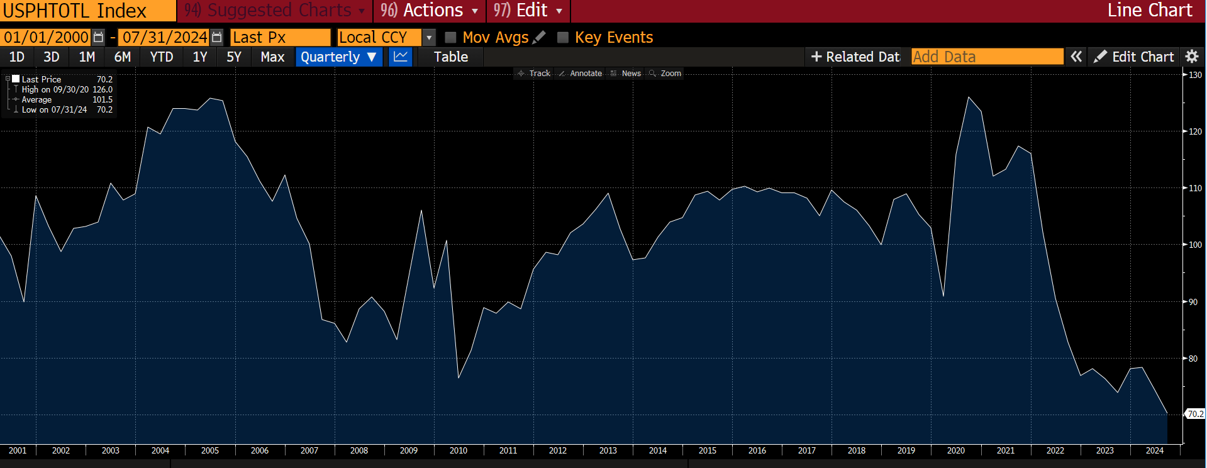
Pending Home Sales Drop to Lowest on Record
Source: Bloomberg.

Slide 18
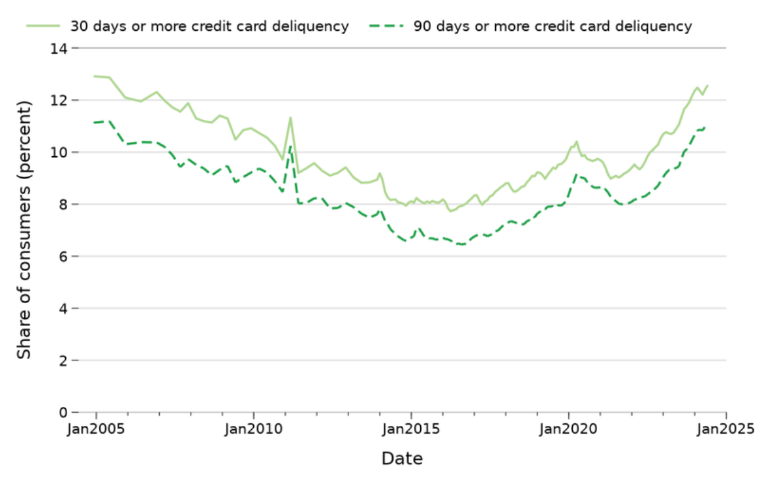
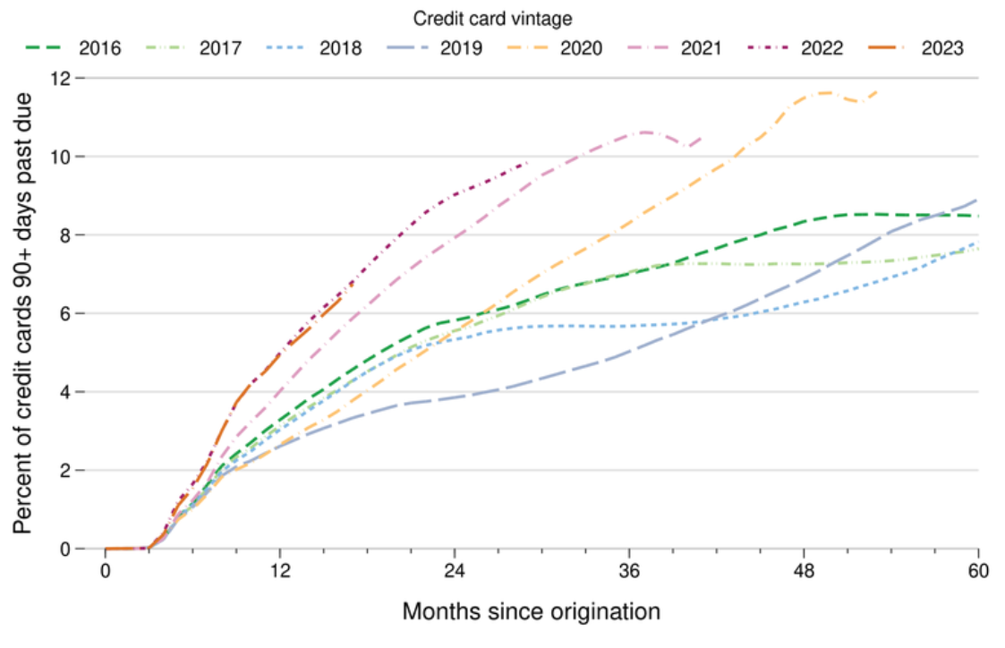
Consumer Credit Weakening – CC Defaults Highest Since 2005/2006
Delinquencies highest in 2021-2023 vintages

Slide 19
Poll Question
What's the biggest concern you have for your local economy?
Inflation
Housing Affordability
Unemployment
Rising Delinquencies

Slide 20
Member Financial Trends

Slide 21
Issues in focus for members
Cost of funds top of mind
Persistent headwinds
Soft landing on doorstep?
Unease intensifies
Regulator emphasis on access and stress scenario analysis
EARNINGS!/Margin management
Deposit funding environment
Economic outlook
Credit containment
LIQUIDITY!

Slide 22
Rebound in loan growth, liquid assets dip
Quarter-over-quarter change in asset composition
Use of Funds ($bn) [banks]
Use of Funds ($bn) [credit unions]
Source: S&P Global Market Intelligence.

Slide 23
Funding pressure persistent
Quarter-over-quarter change in funding composition
Source of Funds ($bn) [banks]
Source of Funds ($bn) [credit unions]
Source: S&P Global Market Intelligence.

Slide 24
Poll Questions
What is your outlook on competing for deposits for the next 12-18 months?
much more challenging
moderately more challenging
no change
moderately easier
much easier
What do your loan growth expectations look like for the remainder of 2024 and into 2025?
strong growth
moderate growth
minimal or limited growth
no growth
decline in balances

Slide 25
Reliance on term funding remains elevated
Cost of funds top of mind as maturities approach
Funding Maturity Outlook [bank members]
Funding Maturity Outlook [credit union members]
Source: S&P Global Market Intelligence.

Slide 26
Margin headwinds persist for banks, expand at credit unions
Share/deposit pricing pressure continues
NIM vs. Cost of Shares/Deposits & Fed Funds Rate
Cost of Time Deposits vs. Cost of Borrowings
Source: S&P Global Market Intelligence.

Slide 27
Credit concerns continue to mount
Heightened focus on CRE exposure and consumer stress
Net Charge-offs ($mm) | 2001Y – 2024 YTD Annualized
Provisions ($mm) | 2001Y – 2024 YTD Annualized
Source: S&P Global Market Intelligence.

Slide 28
On the horizon
Share/deposit retention and gathering efforts face ongoing headwinds
Pivot in interest rate outlook as inflation concerns have eased, labor market cools, and the strength of consumers has weakened
Caution for an economic downturn with softening macro data and tightening credit conditions could influence pullback in lending activity
Access to liquidity and collateral capacity imperative going forward as the ability to sell securities to generate liquidity remains restricted due to underwater security portfolios
  Stress testing and cash flow monitoring will continue to gain attention from regulators
Margin pressure to persist in near-term with greater reliance on term funding but hope for funding cost relief with expected rate cuts
Amid spike in provisions and net charge-offs, lingering credit concerns in some sectors could impact reserve levels
Market volatility is likely to remain heightened with both domestic (election year) and global uncertainties

Slide 29
Funding Strategies & Considerations
Notes:
We’re going to transition now over to a few advance funding strategies and a brief overview on a couple advance products.

Slide 30
Looking ahead – all signs point to rate cuts
Will the Fed move down a gradual path or move more quickly to a policy shift?
Funding considerations for upcoming maturities and general balance sheet funding:
  Cost
    What does market have priced into yield curve?
    Potential for market expectations to change over time
    What does balance sheet need – gaps to fill – and what does our interest-rate risk profile look like?
  Liquidity
    Deposit growth expectations
    Loan demand, capacity to grow
    Organic cash flows
Source: FHLBank Topeka.

Slide 31
Straightforward strategies to prepare institution for success
Move into falling rate environment
Earning Assets and Income Considerations
Funding Considerations
Ensure adjustable-rate notes have reasonable floors
Lock in fixed-rate yields on earning assets and extend duration to manage margins
Identify best earning asset yields with minimal credit risk
Continue to evaluate non-interest revenue sources and improve efficiencies
Ride down the liability curve by reducing duration
Use short maturity or adjustable-rate advances to ride the curve down
Target non-interesting bearing deposits with ancillary services, utilize earnings credit strategies
Evaluate composition and rate sensitivity of deposits

Slide 32
Funding strategy considerations for an evolving rate outlook
Longer-term bullet vs. Rolling short-term bullet vs. Rolling OLOC
SOFR adjustable vs. Rolling OLOC
Putable advances vs. Rolling OLOC / Rolling SOFR adjustable / Rolling short-term bullets
Bullet
SOFR
Adjustable
Putable

Slide 33
SOFR adjustable advance attributes
Offering Rate Comparison
Provides benefit to liquidity metrics
Spread component to SOFR fixed until maturity
Reprices daily
3-month to 10-year maturity
Correlates well with the Effective Fed Funds Rate
Call options available (includes option cost)
(8/27/2024 morning rate indications)
Source: FHLBank Topeka.

Slide 34
Putable advances popular funding option
Putable Advance Activity – Term & First Option Summary
Margin relief offered through cost savings compared to bullet advances
Customizable structures
Extension risk vs. contraction risk
Complements deposit funding
Behaves like CD products
Source: FHLBank Topeka.

Slide 35
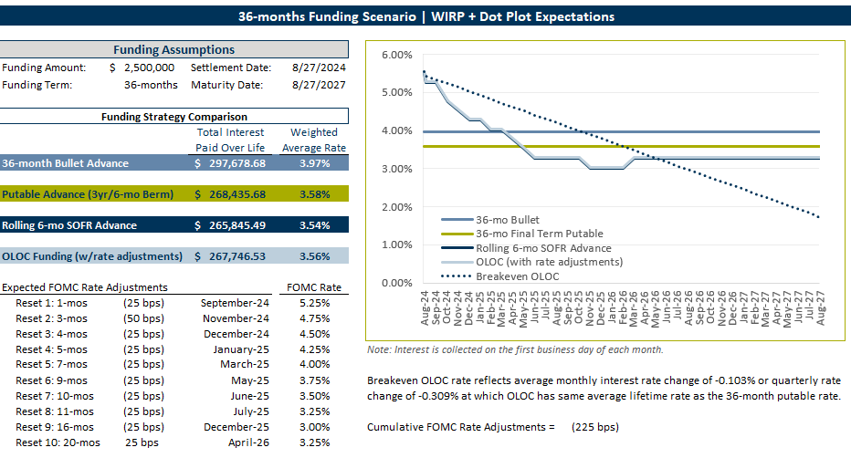
Funding Strategy Illustrations
New tool offered by Member Solutions

Slide 36
Funding Strategy Wrap-up
FHLBank Topeka provides access to funding solutions that can be tailored to meet your desired balance sheet needs
Scenario and breakeven analysis: when comparing funding strategies, look at the tradeoff between what the cost savings may be initially – in the shorter-term – and how much rates may have to move in order for one strategy to look better than another
  Contact your account manager to utilize our Funding Strategy Illustrations tool
Combat margin pressure with liability side of the balance sheet
  Blended funding strategies
  If you have capital and liquidity capacity, consider staying invested to support earnings in near-term
  Advance products can provide a strong alternative to brokered deposits and alternative funding sources

Slide 37
Poll Questions
Has your funding strategy changed with the Fed likely to begin cutting rates?
no change
yes, I plan to renew shorter on the curve for upcoming maturities (CDs, advances, brokered deposits, etc.)
yes, I plan NOT to renew my upcoming maturities
yes, I plan to renew longer on the curve
What is your expected wholesale funding activity for the remainder of 2024 and 2025? [multiple selections]
increase in borrowings, including advances
increase in brokered deposits
no change, maintain current balances
decrease in borrowings, including advances
decrease in brokered deposits
no wholesale funding use

Slide 38
FHLBank Update on Capitol Hill

Slide 39


A Tale of Two Election Outcomes - Impact to the FHLBank System
Could mean new FHFA leadership for the FHLBank System
Potential for increased scrutiny by the FHFA for the FHLBank System
The System has grown increasingly concerned that our consistent role as a reliable collateral-based lender could be meaningfully impacted by the reality of having a politically appointed regulator.
We firmly believe, above all, that Congress ought to dictate the ongoing mission and purpose of the System, rather than a politically-appointed regulator.
We don’t wish to become a de facto regulator and will continue working with other prudential regulators to help them understand how policy decisions regarding the discount window, brokered deposits, etc. could have a series of unintended consequences downstream, so we encourage you to be open and honest with your regulators to help them understand more granularly how you utilize the consistency of the System to confidently grow your communities.

Slide 40
Poll Question
Who Do You Think Wins the Presidential Election?
Trump / Vance
Harris / Walz

Slide 41
FHLBank Community & Grant Programs

Slide 42
Housing & Community Development (HCD) Programs
Affordable Housing Program (AHP)
The FHLBank system’s Affordable Housing Program is the largest privately funded housing grant program in the United States. FHLBank members, in partnership with public and private housing development organizations, prepare a detailed application for this competitive program.
TurnKey (HSP, HSP+, HOPE)
TurnKey, FHLBank’s new suite of products designed to provide assistance and address the challenges of attaining homeownership in Colorado, Kansas, Nebraska and Oklahoma.
Community Housing Program (CHP)/Community Development Program (CDP)
CHP and CDP provide advances priced below FHLBank’s regular advance rates to help members finance housing in their communities, and finance qualifying commercial loans, farm loans and community and economic development initiatives in the areas they serve.
Native American Housing Initiative (NAHI)
NAHI was first implemented in 2023 as a voluntary grant program, unique to FHLBank Topeka, benefiting our Native American communities across the district.
Notes:
We currently administer four programs in HCD. At a high level:
Our Affordable Housing Program or AHP is our competitive grant program. When you combine the system as a whole, it is the largest privately funded housing grant program in the nation.
TurnKey provides down payment assistance to homebuyers in our district.
The Community Housing Program and Community Development Program or CHP/CDP are our discounted advance programs that promote and encourage community lending.
Voluntary programs are funding BEYOND the regulatory requirement – so outside of our 10% obligation, these are funds that we are choosing to provide to assist with housing needs.

Slide 43
Turnkey Funding Update | $18.6 Million Assisting 1,300 Households
HSP
  $12.9 Million, 891 Households
HSP +
  $1.5 Million, 58 Households
HOPE
  $4.2 Million, 350 Households

Slide 44
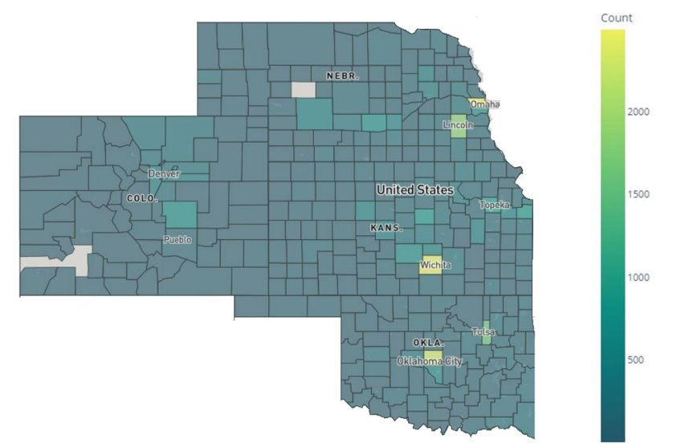
FHLBank Topeka – Fulfilling Dual Liquidity and Housing Mission
More than 98% of counties in our district have been impacted by member’s use of our:
Housing and community development programs,
MPF business activity and
Eligible pledged collateral

Slide 45
Poll Questions
What type of housing grant program would be most beneficial to your institution? [multiple selections]
new affordable housing construction
rehabilitation of existing homes
rental assistance programs
down payment assistance
rate buydown program
other
none
Which of the following areas of need within the communities your institution serves could benefit most from FHLBank grant programs? [multiple selections]
small businesses
agriculture
rural housing/development
tribal community and organizations
infrastructure
other
Notes:
[Allow for multiple selections. Do not share poll responses to this question]

Slide 46
FHLBank is Here to Help

Slide 47
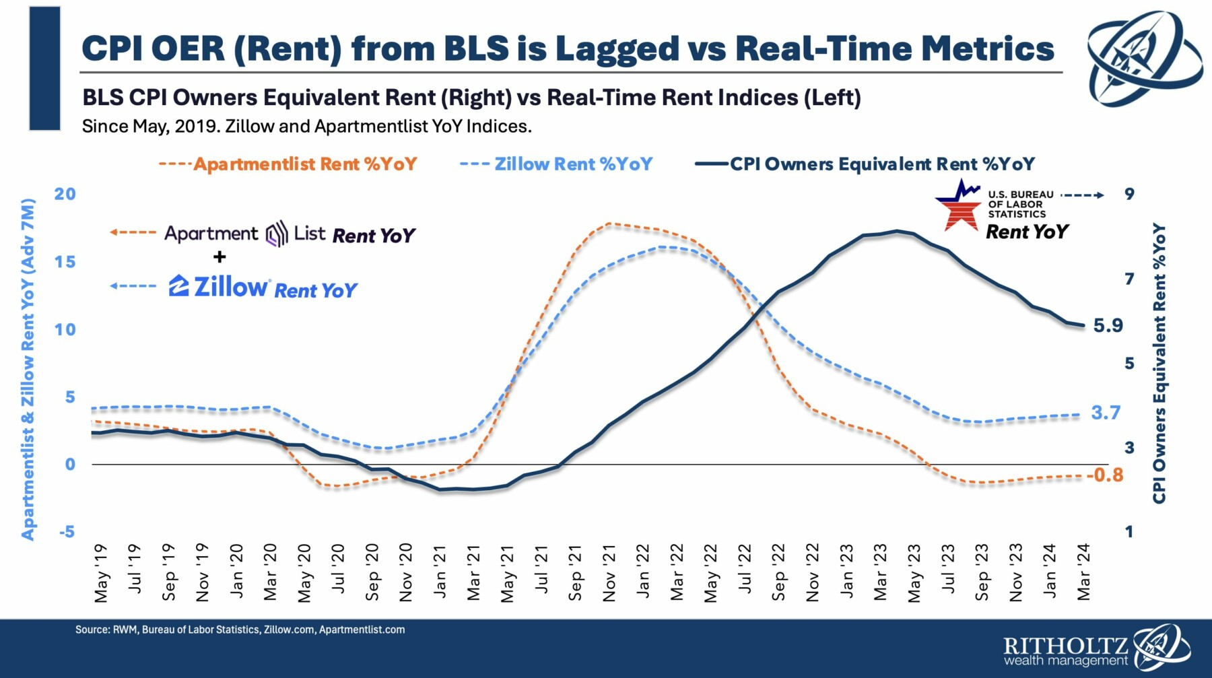
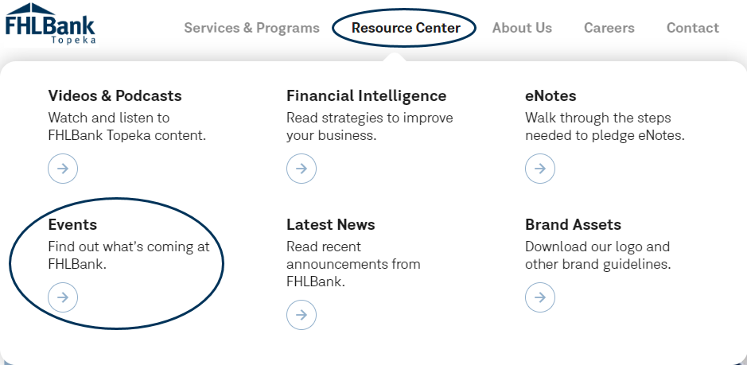
Visit our Resource Center for upcoming events!
Resource Center - Federal Home Loan Bank Topeka (fhlbtopeka.com) [link]
Notes:
Look for descriptions and registration information throughout the year at fhlbtopeka.com/events.

Slide 48

Not too late! Sign up for Kansas and Oklahoma Regional Meetings
Kansas | Tuesday, September 24th
Oklahoma | Wednesday, October 16th
Prairie Band Casino & Resort
Mayetta, Kansas
8:00 am – 5:30 pm
Kickingbird Golf Club
Edmond, Oklahoma
8:00 am – 5:30 pm
Visit www.fhlbtopeka.com/resource-center/events to register or open FHLBank email communications for a link.
Notes:
[note agenda and speakers/topics]
Each meeting will feature two outside speakers, one is Matt Harris from Hilltop Securities on liquidity and interest rate risk with your balance sheet and we return Russell Evans for an economic update.
You’ll also hear an FHLBank update from Jeff Kuzbel and Lance Liby, along with an election update from Ryan Gilliland – our Director of Government and Industry relations.

Slide 49
FHLBank Contacts
Tony Venditte
Regional Account Manager – Central and Eastern Nebraska and NE Kansas
tony.venditte@fhlbtopeka.com
402.890.6838
Jeff Steiner
Regional Account Manager – Most of Kansas
jeff.steiner@fhlbtopeka.com
785.478.8170
Drew Simmons
Regional Account Manager – Oklahoma
drew.simmons@fhlbtopeka.com
405.831.7678
Rusty Davis
Regional Account Manager – Colorado, Western Kansas and Western Nebraska
rusty.davis@fhlbtopeka.com
720.212.9873
Lending
800.809.2733
Wire Services
800.934.9473
Housing & Community Development
866.571.8155
MPF Program
866.571.8171
Collateral & Safekeeping Operations 877.933.7803
Member Credit Analysis
800.905.2733
Notes:
Thank you for attending – our goal is to help you explore strategies that contribute to your profitability and efficient use of capital.

Slide 50


THANK YOU FOR JOINING US TODAY!
Next FI Live Session:
Thursday, Nov. 21 at 2 p.m. CT

